Slide 1
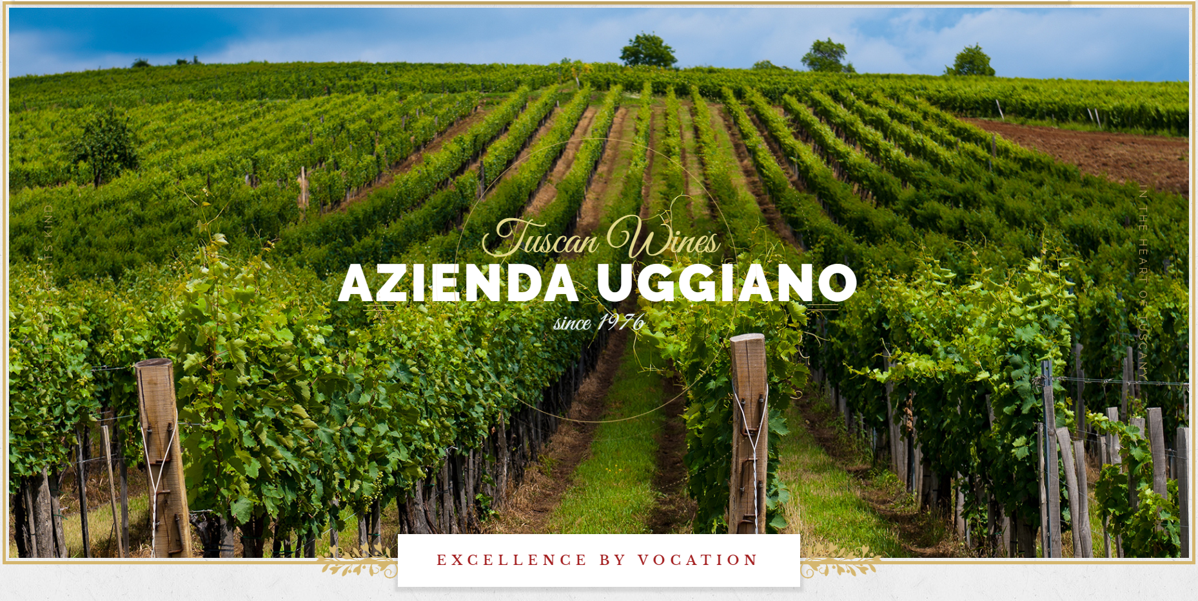


Slide 2


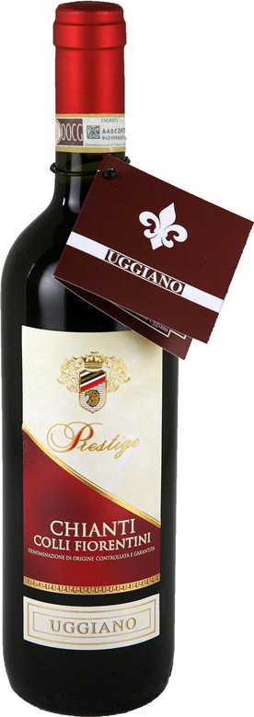
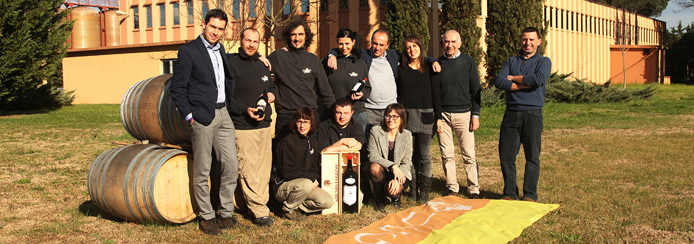
TUSCAN WINE PRODUCTION
The beauty and tradition of Tuscany, combined with passion, rigour and attention to the production process: this is Azienda Uggiano, in San Vincenzo a Torri.

Slide 3
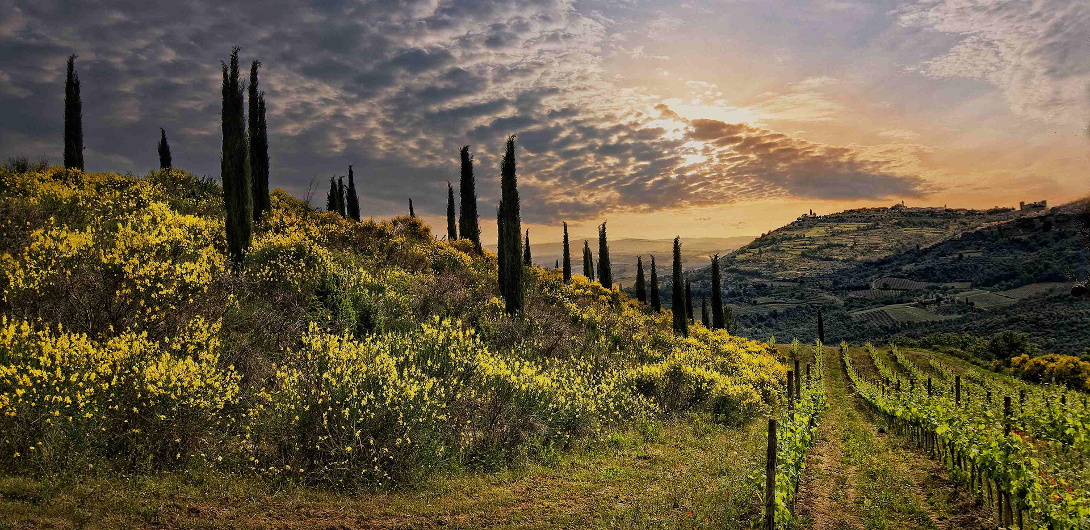
The Uggiano winery is tucked away in the Florentine hills among the monasteries, churches, rustic villas and olive orchards.
OUR VINEYARDS COVER AN AREA OF ABOUT ONE HUNDRED HECTARS
The vineyards spread over rolling hillsides at an altitude of 250 to 300 meters between the Tuscan villages of Montepertoli, San Casciano, and San Vincenzo a Torri.

Slide 4

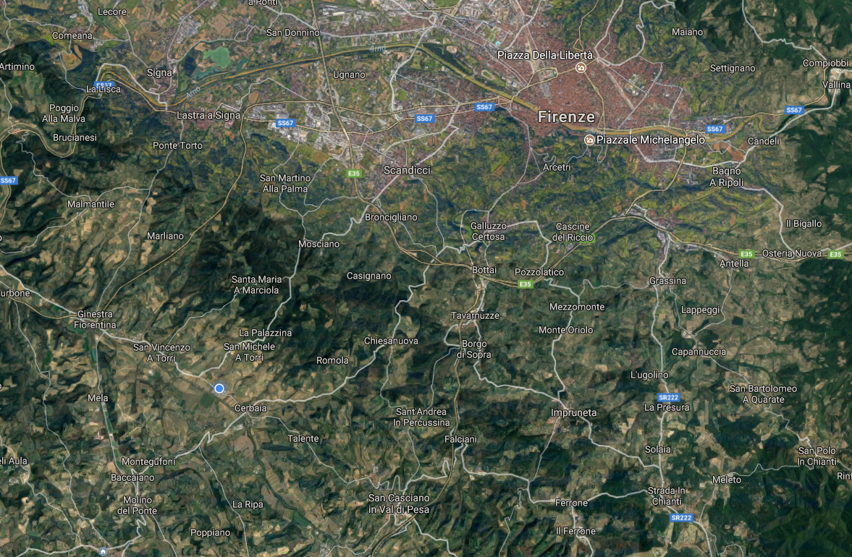
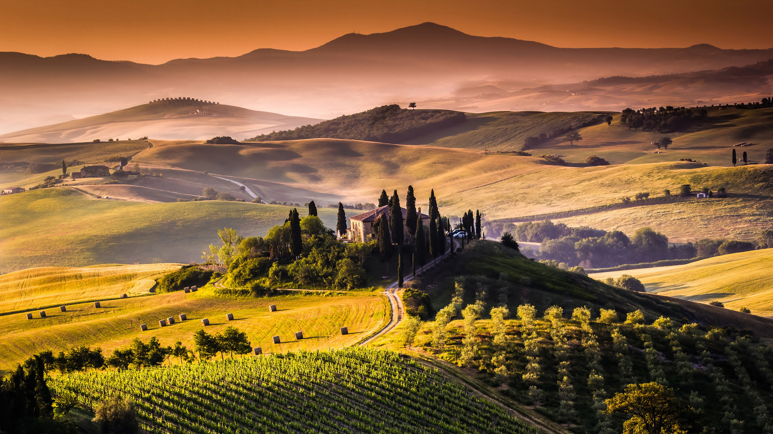

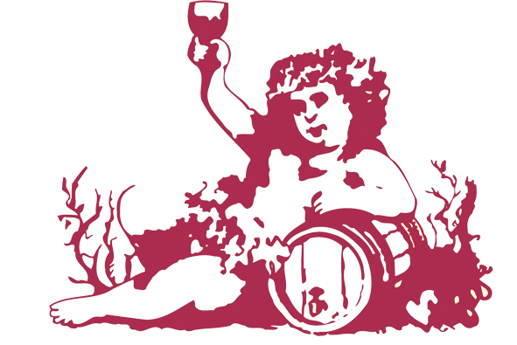
We are located on the border between Chianti Classico and Chianti Colli Fiorentini regions.
We take advantage of this strategic position to produce some of the most typical Tuscan wines.

Slide 6
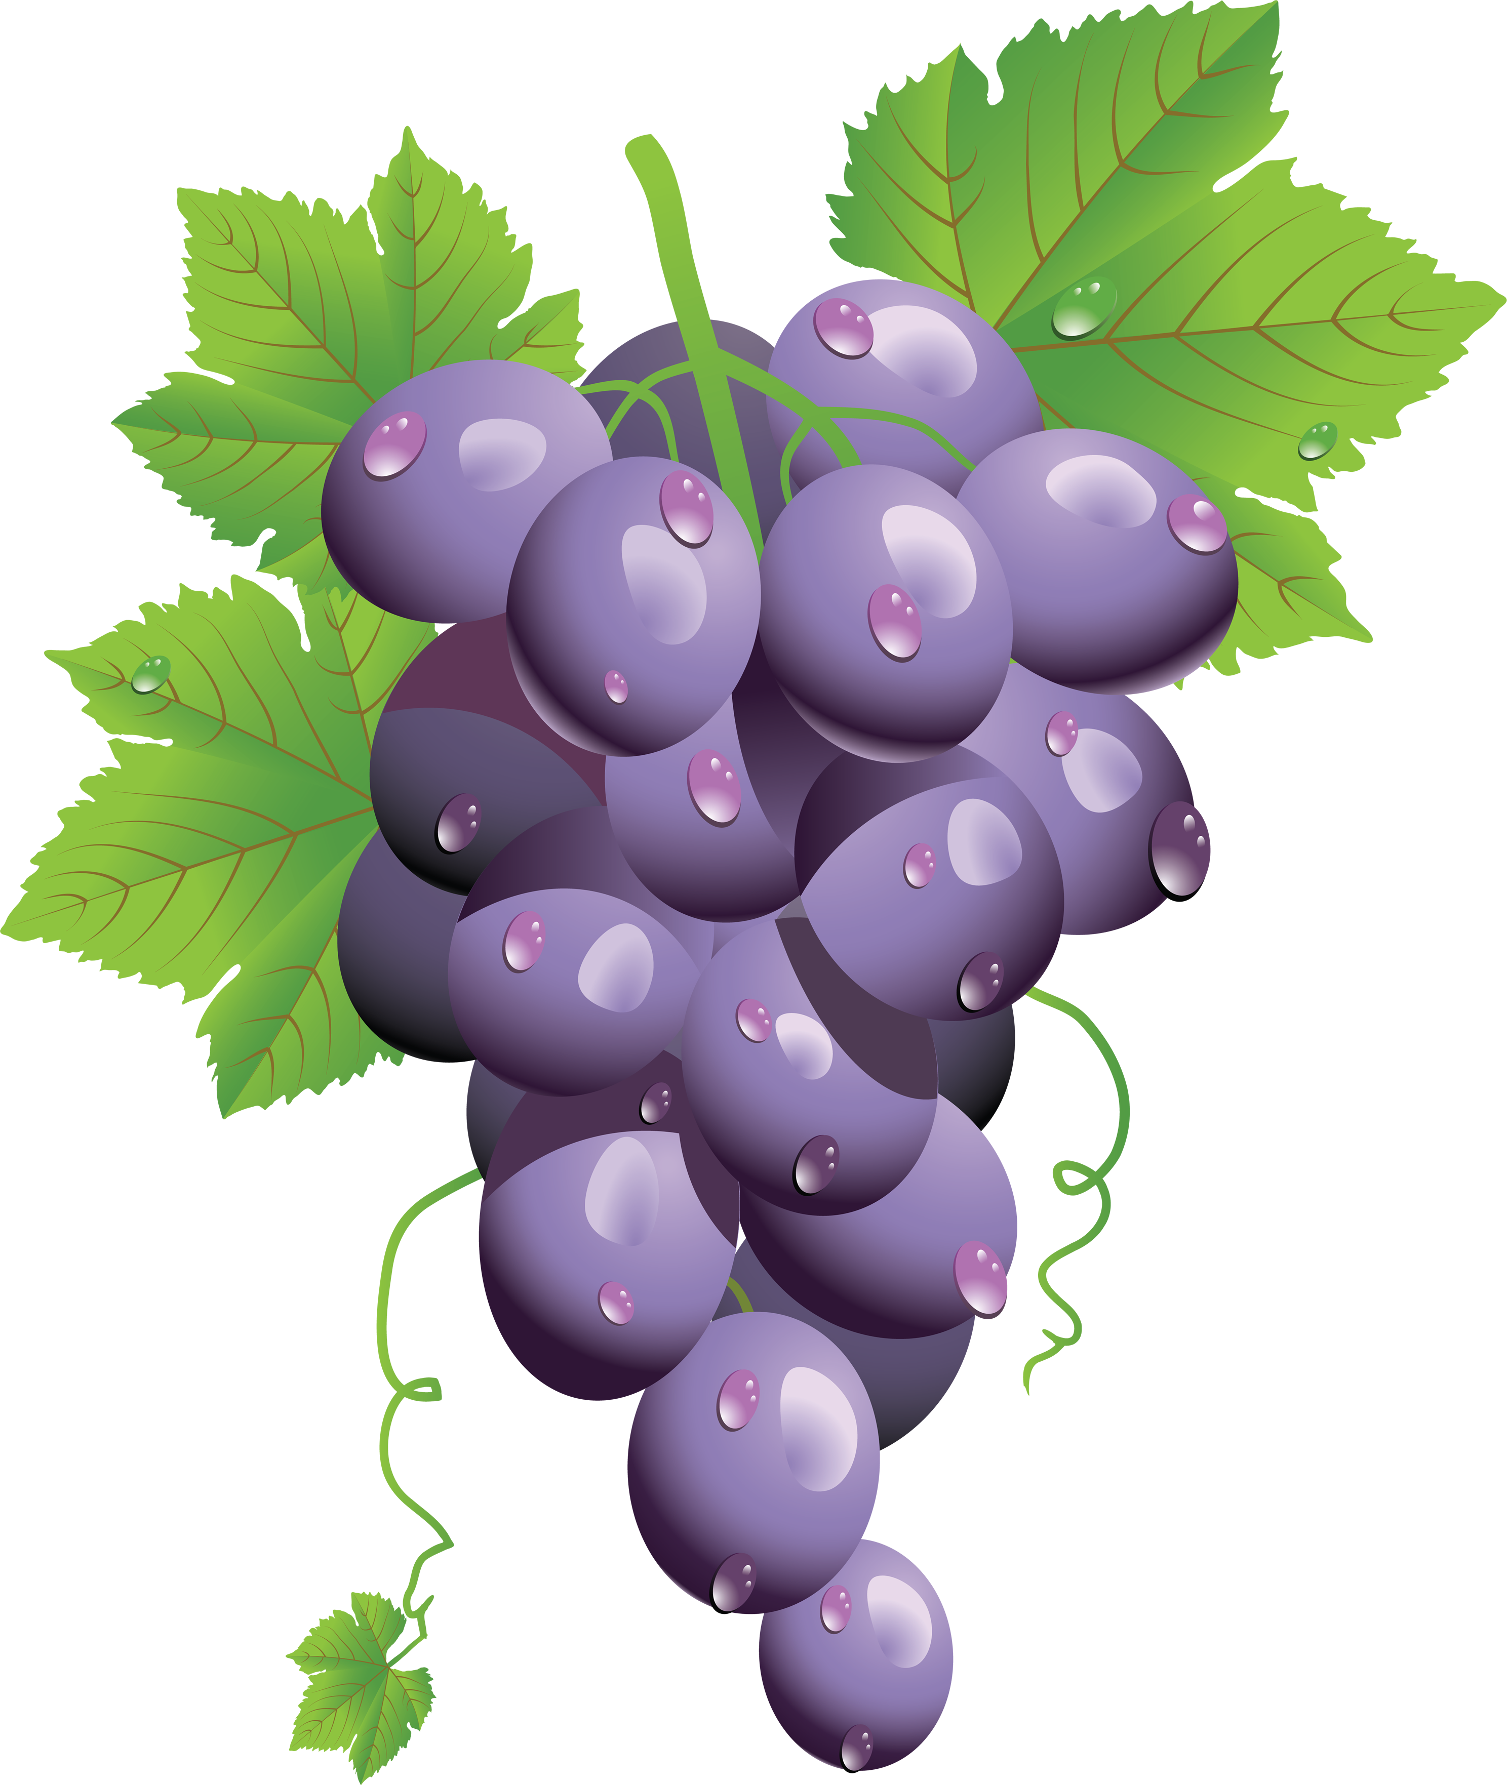
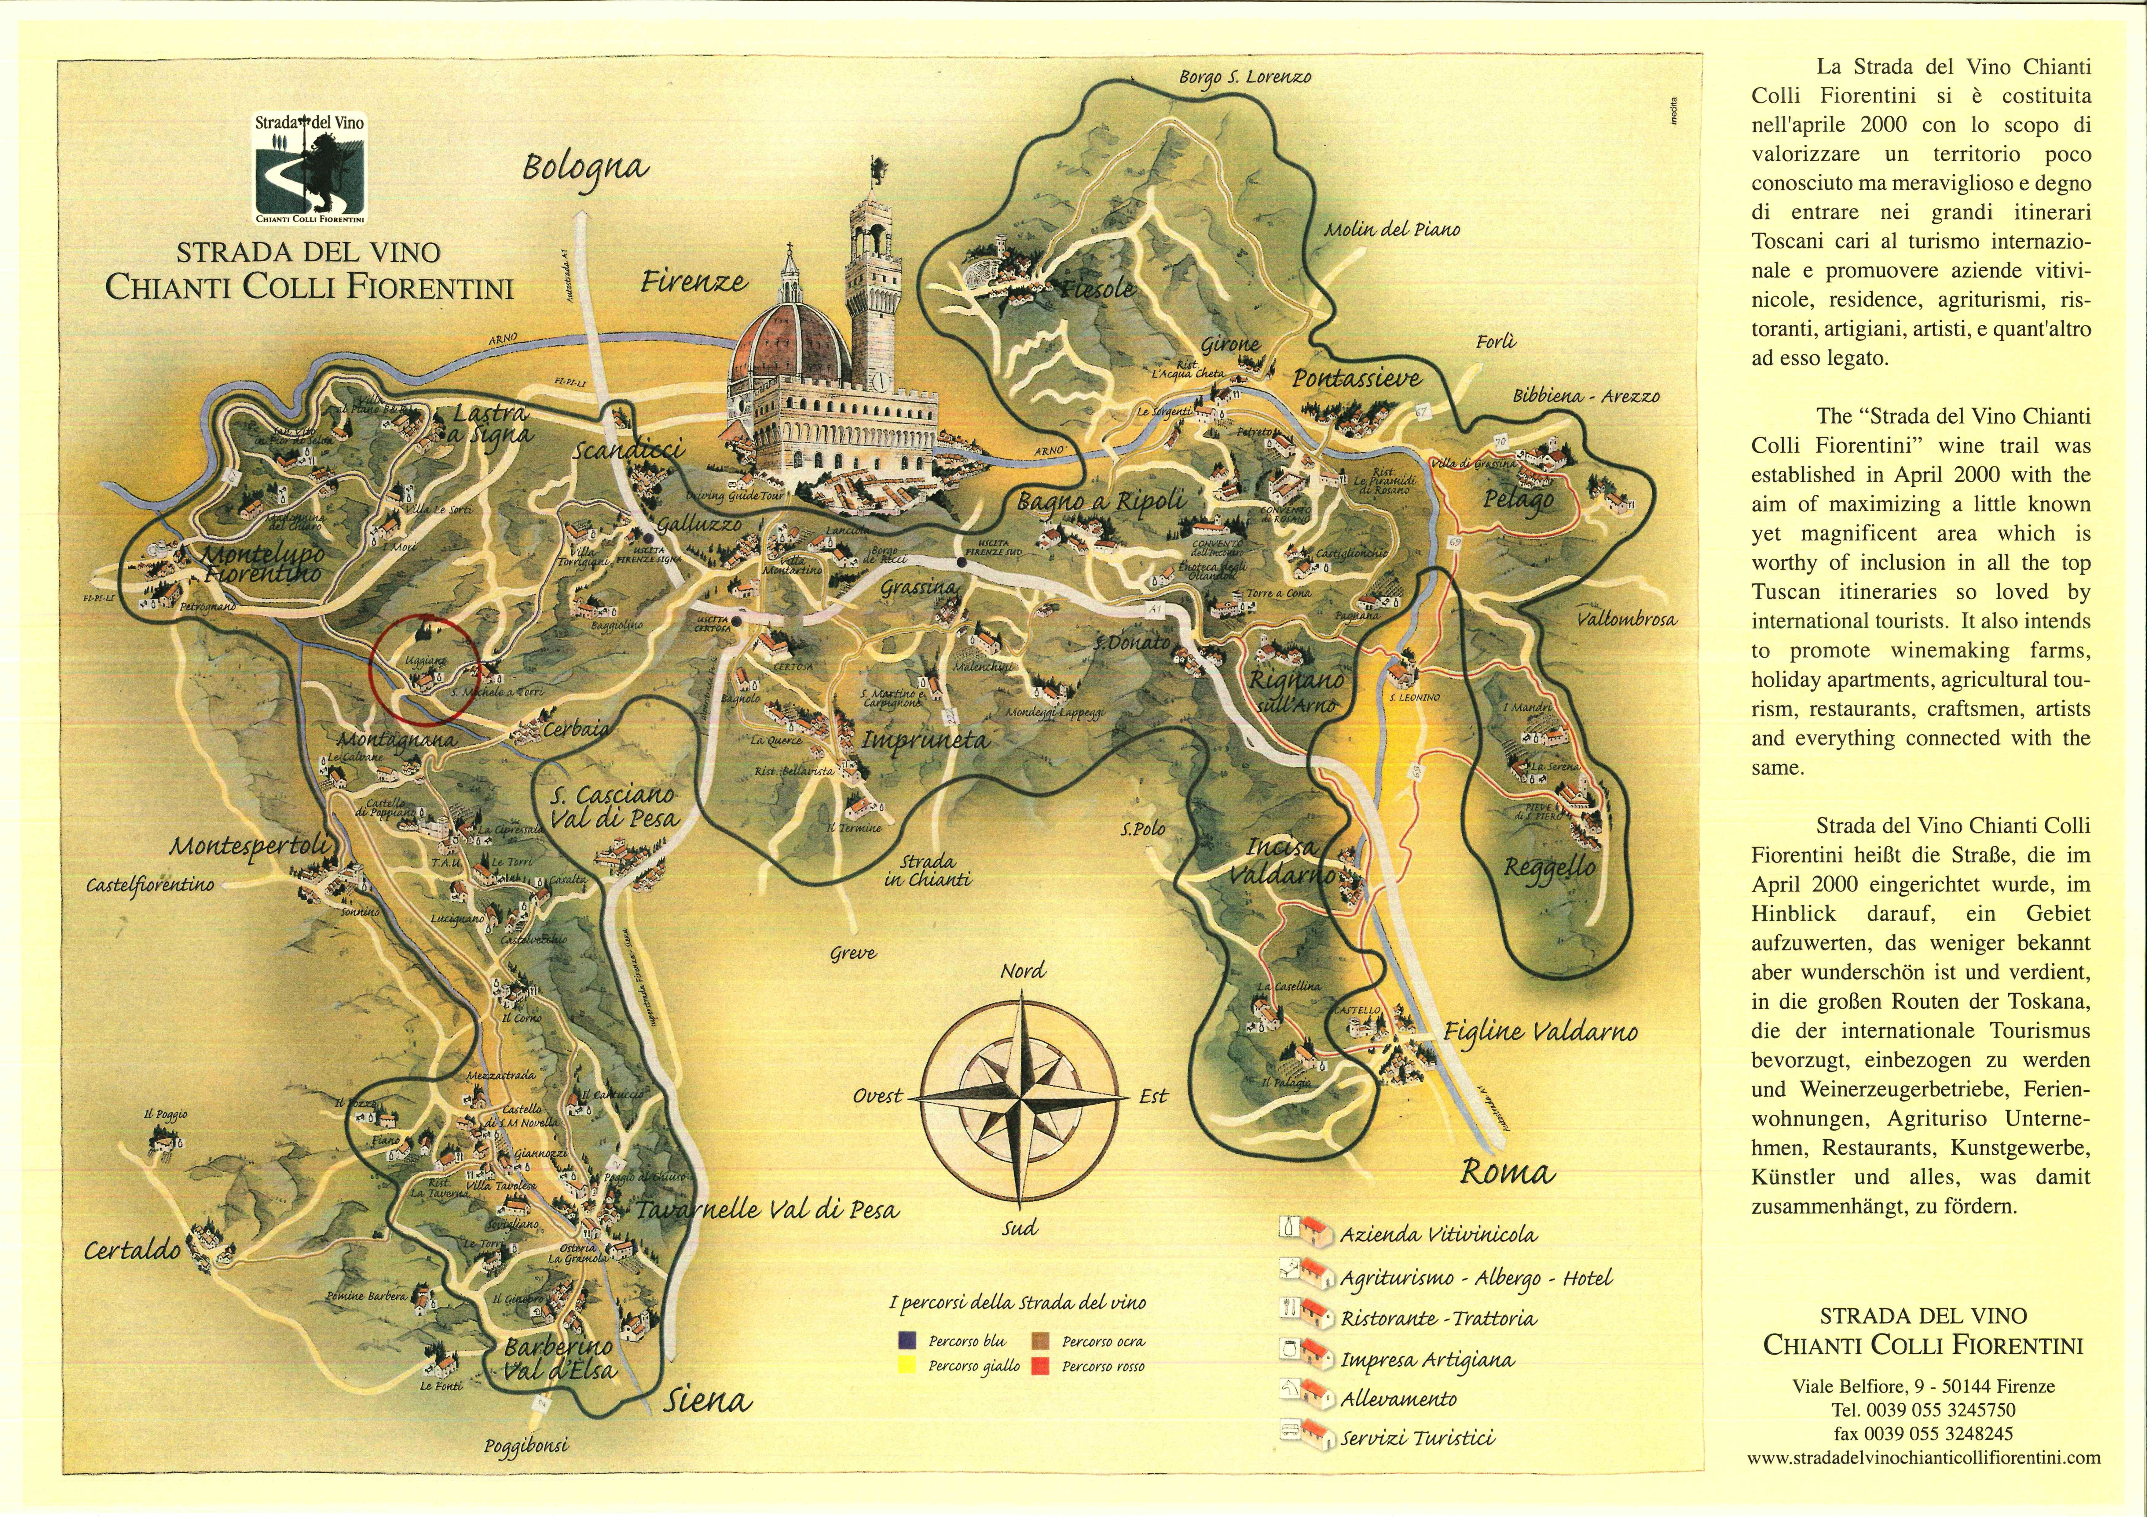
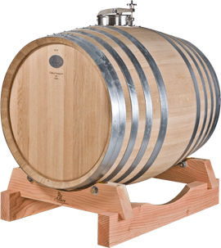
CHIANTI COLLI FIORENTINI

Slide 7
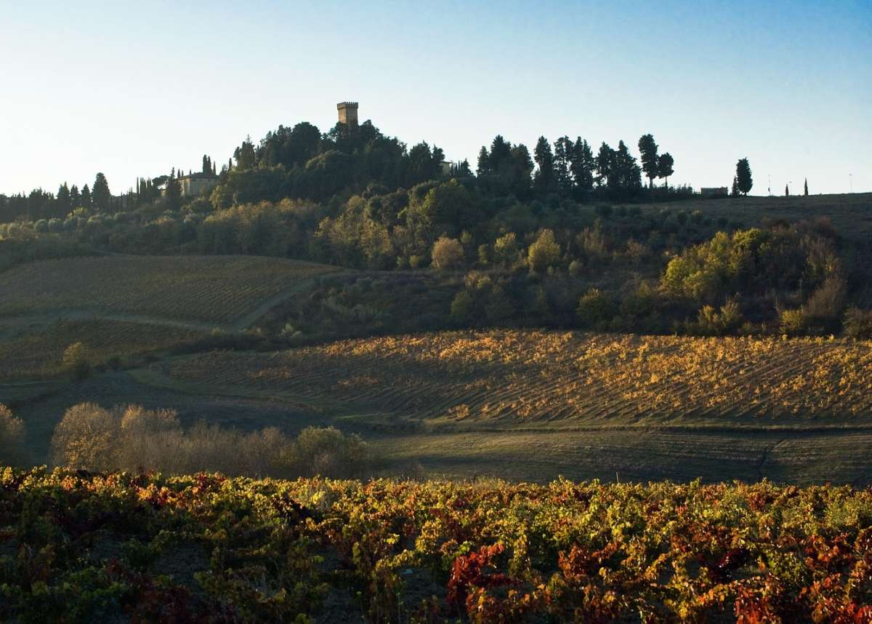
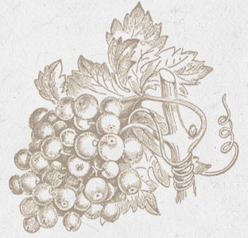
The Uggiano winery was founded in the early 70’s in the Castle of Montespertoli by a group of businessmen from Bergamo sharing a great passion for Tuscan wines and inspired by French-school enologist Dr. Giuseppe Losapio.
In 1976 the cellars of the Uggiano winery were enlarged
and relocated to San Vincenzo a Torri in proximity of the Pesa river valley. In this context, Uggiano produces and distributes its wines all around the world.

Slide 8
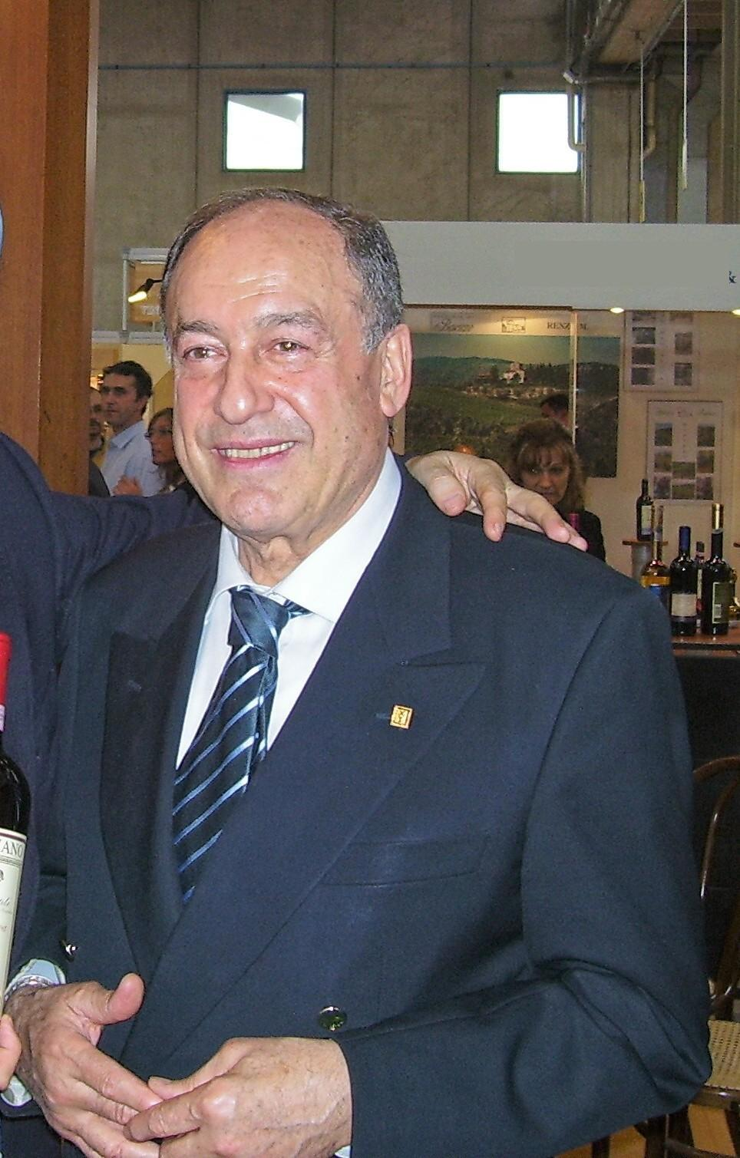
Our team have embraced the heritage of Dr. Giuseppe Losapio; a business dating back to the Seventies, nestled in the Tuscan hills, to charge it with enthusiasm and innovation. We check every production phase, step by step, bottle by bottle, with patience and precision to meet the demands of the most discerning palates, also on an international scale. Without ever forgetting our ties with the Tuscan land.
DR. GIUSEPPE LOSAPIO founded Uggiano winery in 1976
Mr. Losapio has a long history of winemaking

Slide 9
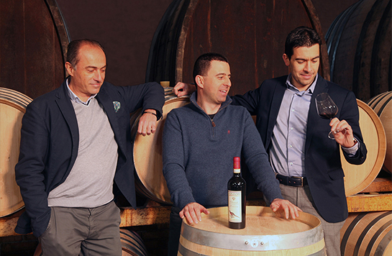

Taking the professional reins from Giuseppe Losapio, 3 historical partners came into the business to fly the flag of Uggiano traditions with pride: a carefully selected, young and dynamic team whose main aim was to make people one of the core strengths of the business.
Fabio Martelli, Daniele Prosperi, Giacomo Fossati
In the year 2016 Uggiano celebrates the fortieth anniversary of its foundation and looks to the future by focusing on technological innovation and ongoing quality.

Slide 10
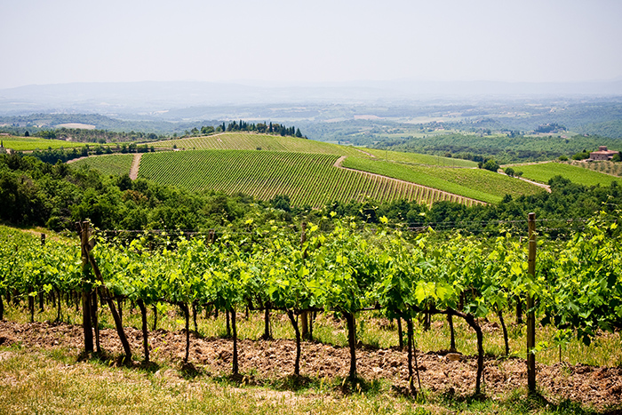
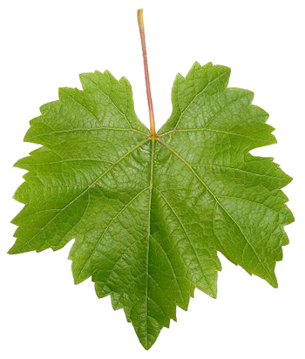
Clay soils are predominant in our region.
These soils are composed by two particular types of clay, Galestro and Alberese
Deep water, strong sunlight and high temperatures are crucial elements to obtain grapes and wines of
outstanding quality.

Slide 11
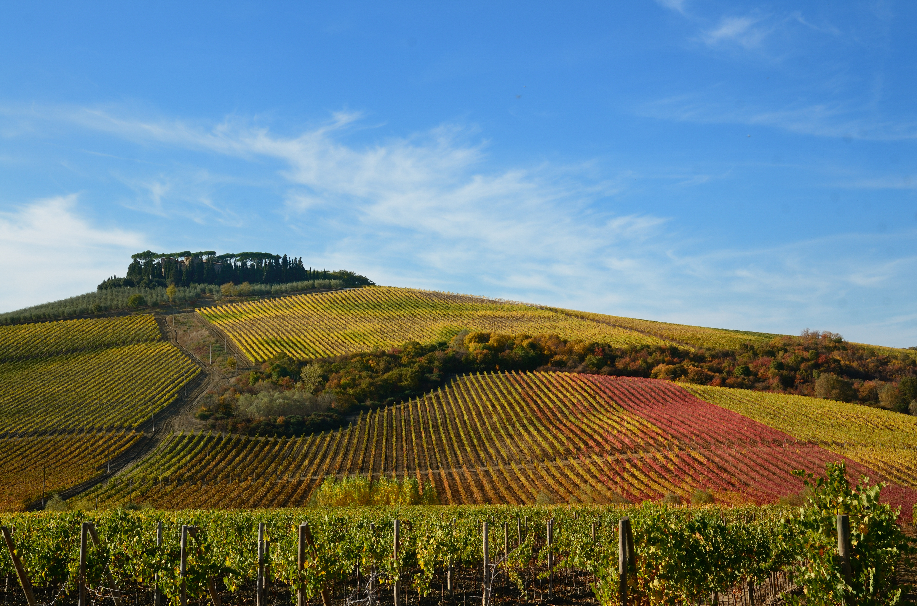
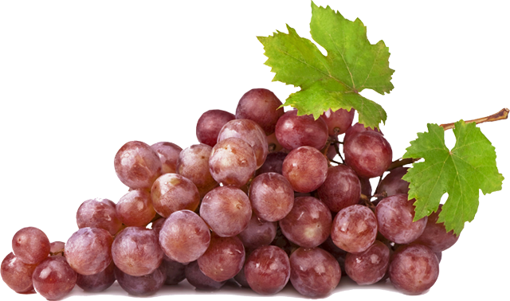
In our winery we mainly grow Sangiovese and black Canaiolo grapes, even though we have some small plots planted with Cabernet Sauvignon, Merlot, Syrah and Chardonnay grapes.
Red grapes are grown with a vine training system called spurred cordon, while the white grapes are grown at guyot

Slide 12
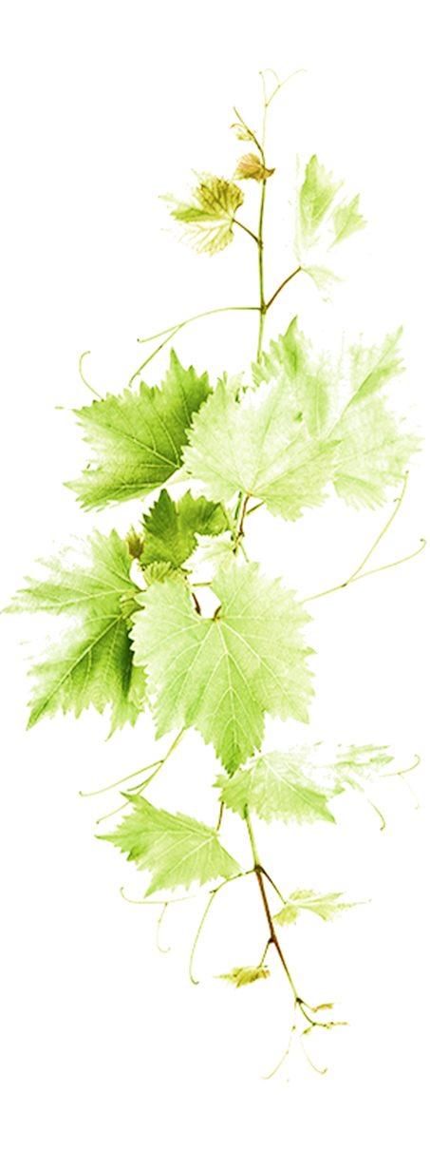
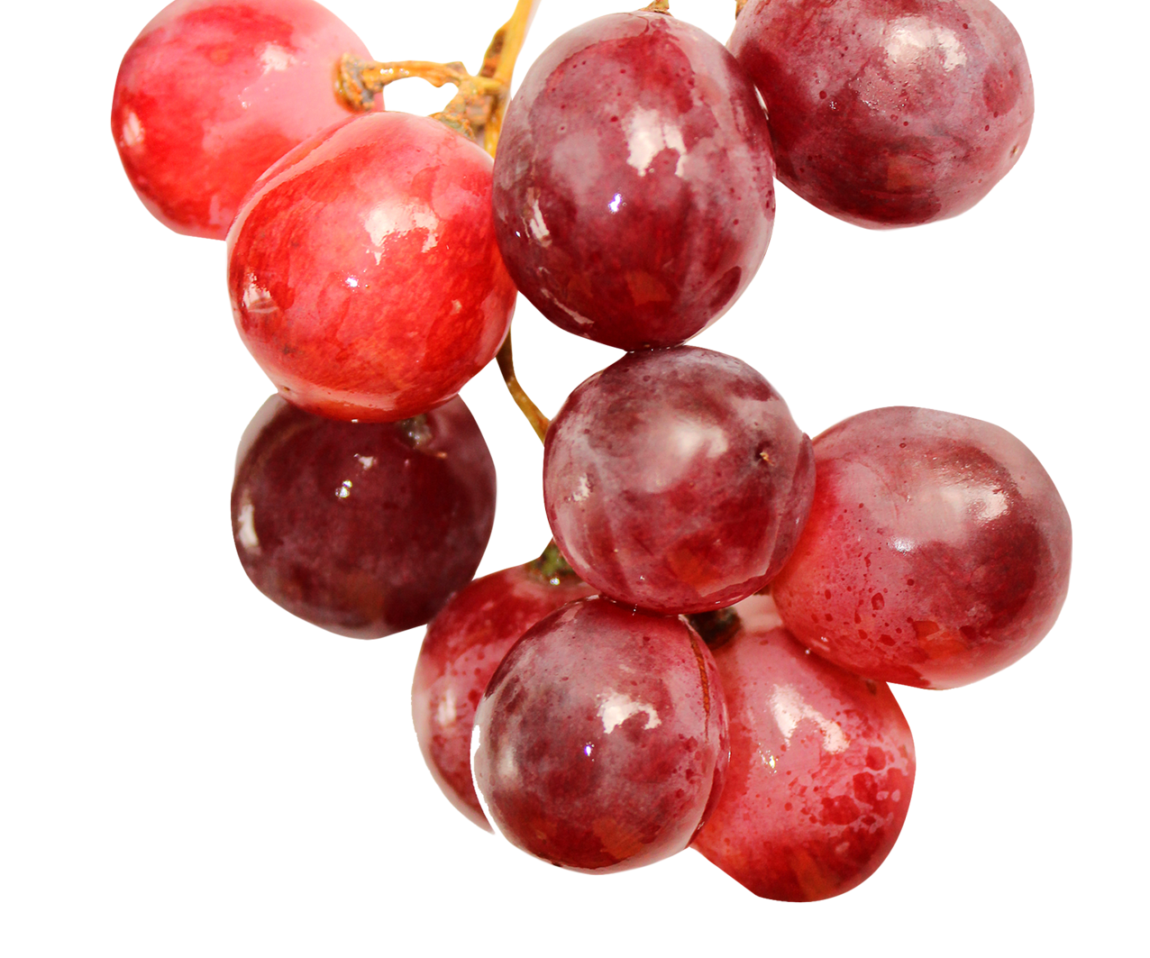
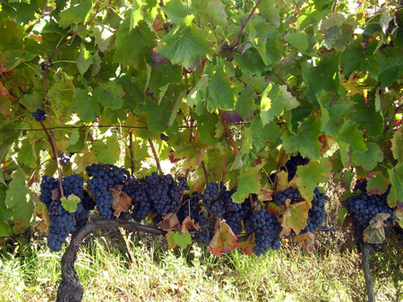
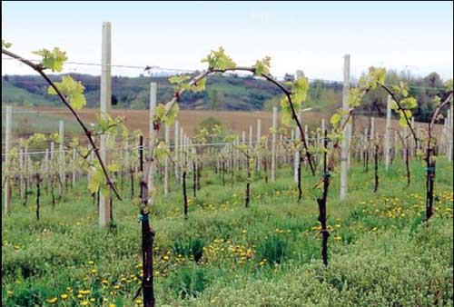
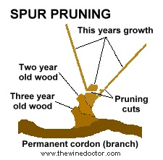
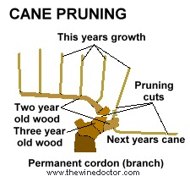
SPURRED CORDON
The main branch or cordon is kept each year with only individual canes being pruned during the winter. The older wood contains many reserve substances that are crucial for the sinthesys of polyphenols and tannins
GUYOT
The vine is pruned down to the spur in winter, leaving only one strong cane which is then trained into becoming the main branch for next year's crop. Younger branches produce a fresher and more aromatic wine

Slide 13
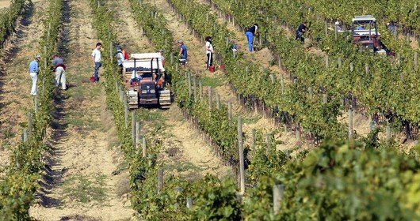
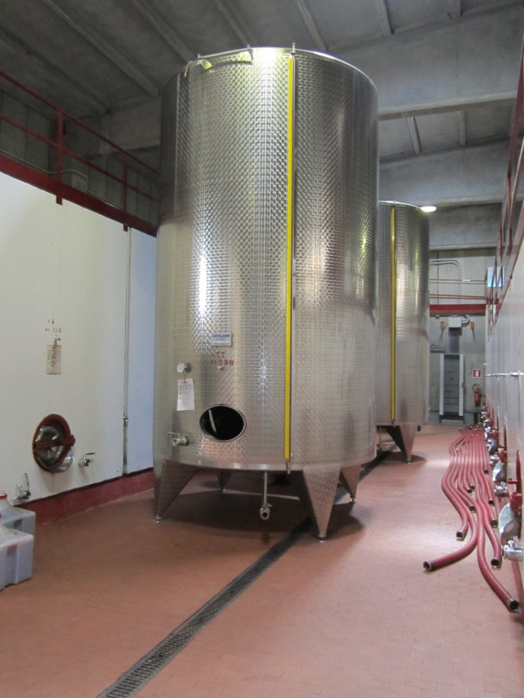
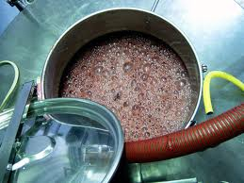
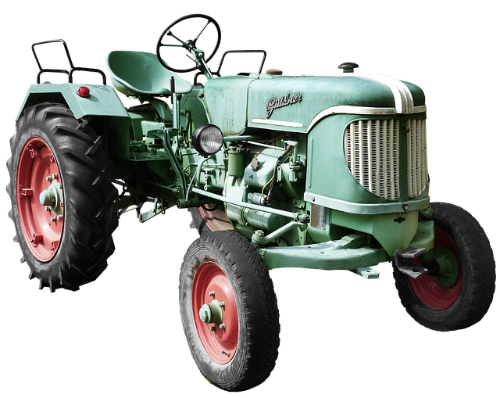
Our wines are made using traditional winemaking methods
The harvest is both mechanical and by hand; we use selected yeasts and we carefully check the fermentation
we pay particular attention to the ageing

Slide 14

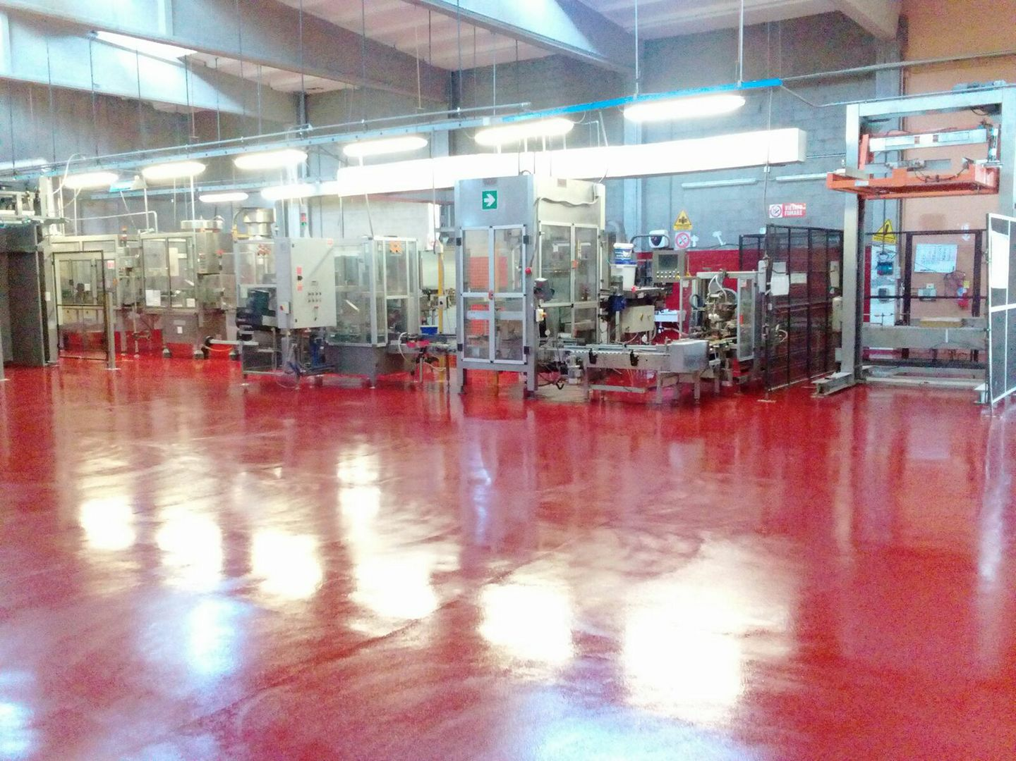
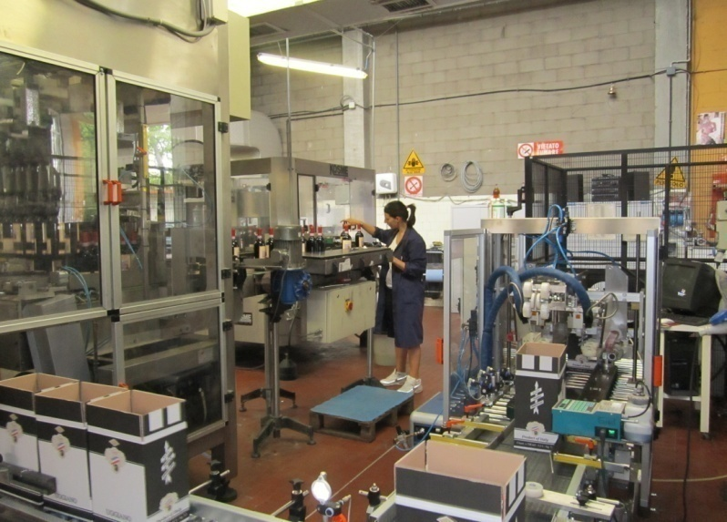
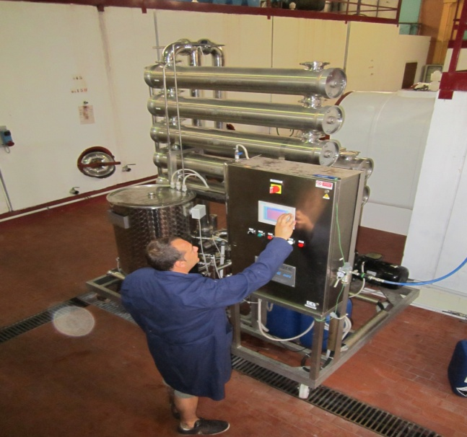
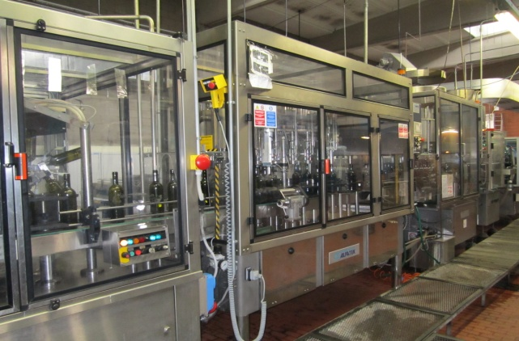
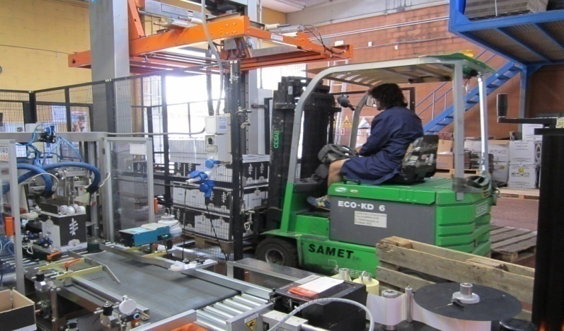
THE WINERY
Usually, upon fermentation, ready to drink wines are stored in stainless steel tanks or in 30/60 hl big oak casks till the final filtration and then bottling.

Slide 15


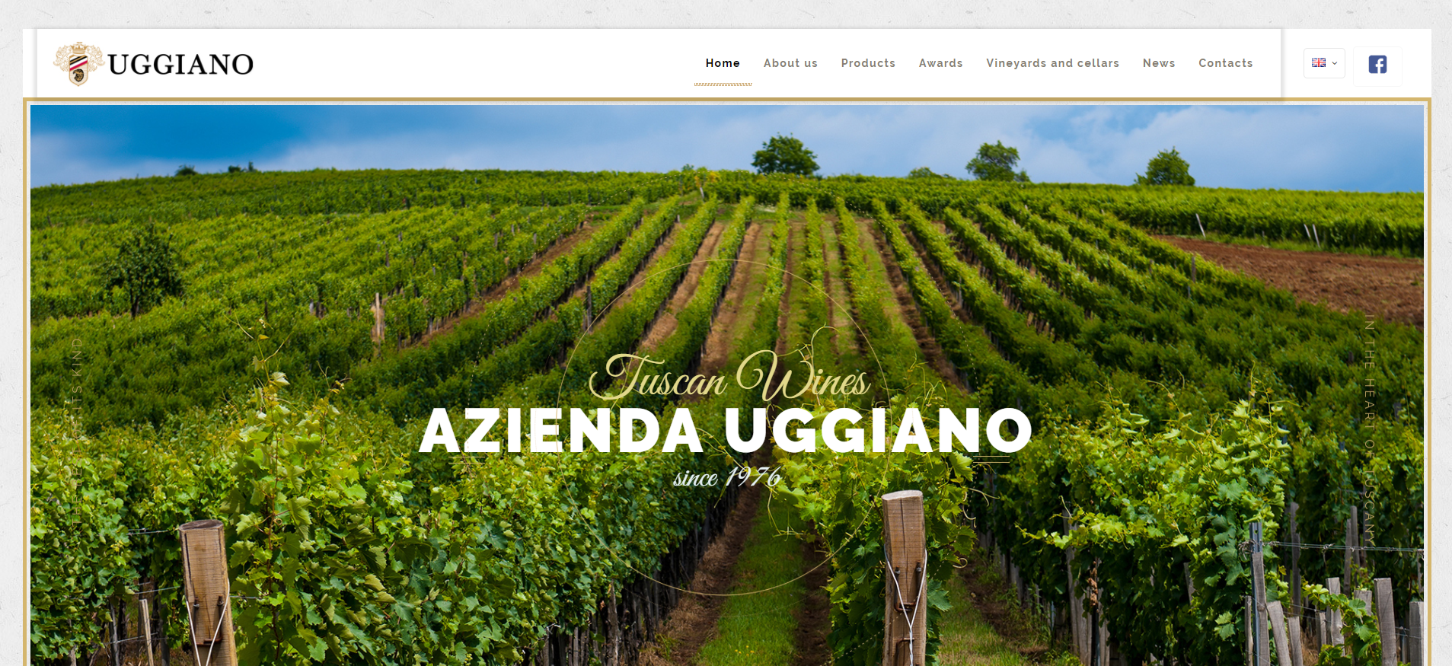
Azienda Uggiano srl
Via Empolese 20/D
50018 San Vincenzo a Torri (Firenze)
@Azienda Uggiano
www.uggiano.it

